Slide 1


NEXT GEN EMPLOYABILITY PROGRAM
CREATING A FUTURE-READY WORKFORCE
Student Name :
Dhanesh Lakhwani
Student ID :
College Name :
STU6465bad29b4b01684388562
Kalinga University , Raipur (C.G.)

Slide 2
CAPSTONE PROJECT SHOWCASE
Tomato - Food Delivery Website
Abstract | Problem Statement | Project Overview | Proposed Solution | Technology Used | Modelling & Results | Conclusion | Q&A

Slide 3
Abstract
1
Tomato is a full-stack food delivery website built using the MERN stack (MongoDB, Express.js, React.js, Node.js).
2
The platform allows users to browse, select, purchase, and manage food orders with a secure authentication system.
3
The system updates orders and restaurant details in real-time, ensuring a seamless experience
4
This project enhances user authentication, order tracking, and restaurant management for efficient food delivery.

Slide 4


Problem Statement
Need for Efficient Food Delivery: People require fast and reliable online food delivery services.
Challenges in Existing Platforms: Many platforms lack real-time updates, smooth user experience, and a seamless authentication system.
Objective: Develop a Zomato-like platform that provides an optimized user experience, better authentication, and real-time updates.

Slide 5

Project Overview
Tomato is an online food ordering system where users can:
Browse restaurants and food menus
Place and track orders in real-time
Use secure login/signup authentication
Manage restaurant listings and food items
The project is developed using MERN stack and follows an optimized UI/UX approach.

Slide 6
Proposed Solution
User Authentication: Secure login/signup with JWT authentication.
Restaurant & Food Management: Restaurants can add and update their food items.
Order Tracking: Users can track real-time order updates.
Payment Integration: Secure online payment gateway integration.
Modern UI/UX: Smooth interactions using React.js for a seamless experience

Slide 7
Technology used
Frontend: React.js
Backend: Node.js, Express.js
Database: MongoDB
Authentication: JWT (JSON Web Token)
Hosting & Deployment: Vercel, MongoDB Atlas

Slide 8
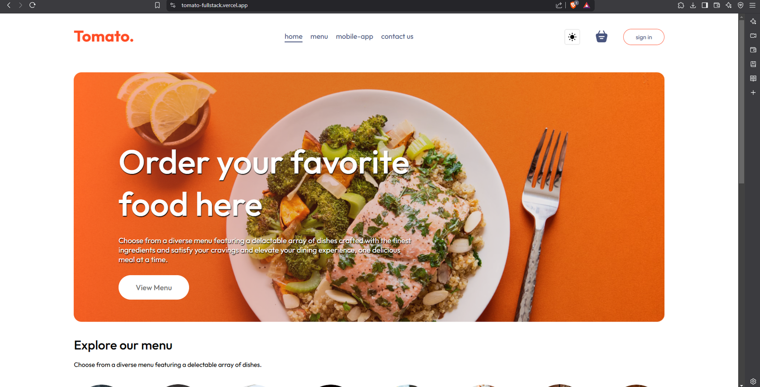
Modelling & Result

Slide 9
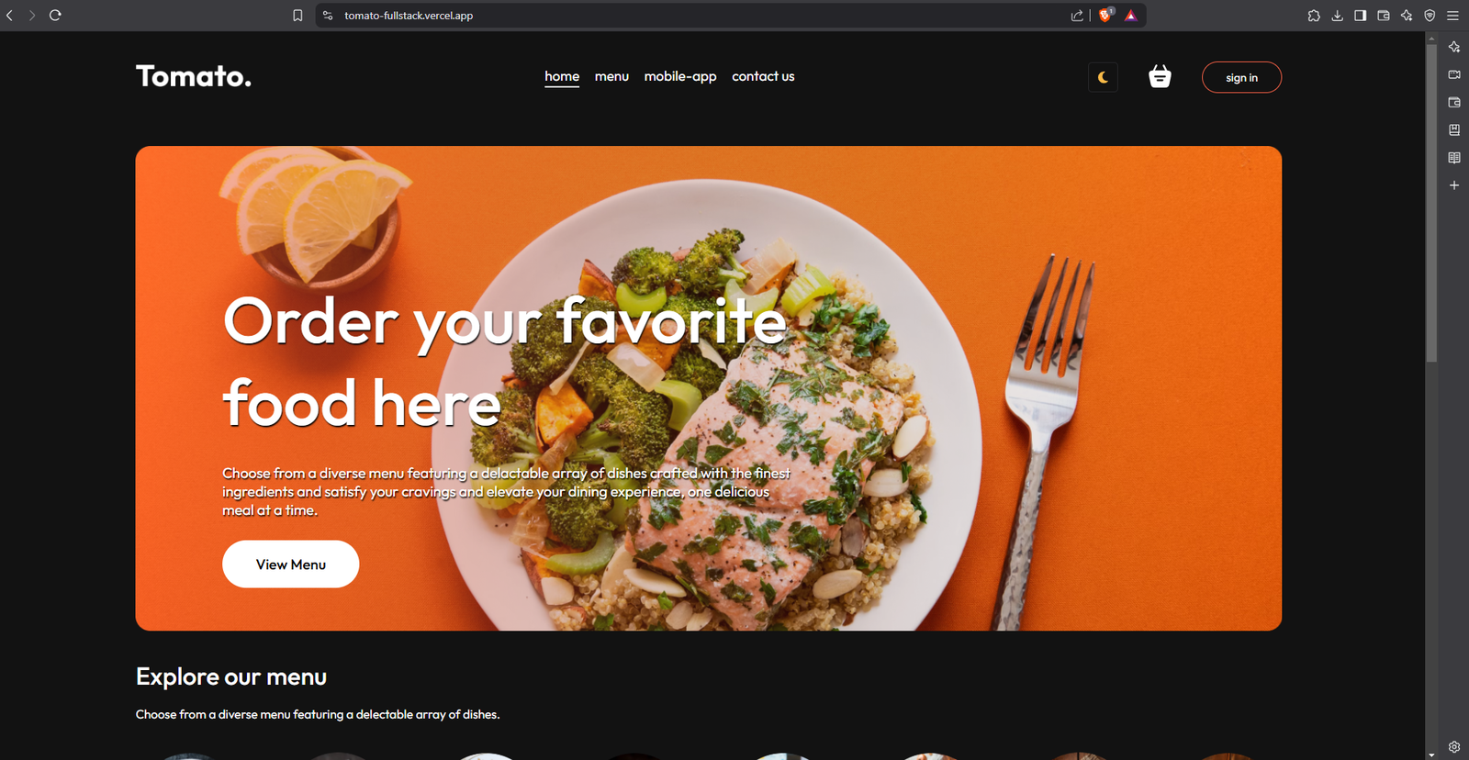
Modelling & Result

Slide 10
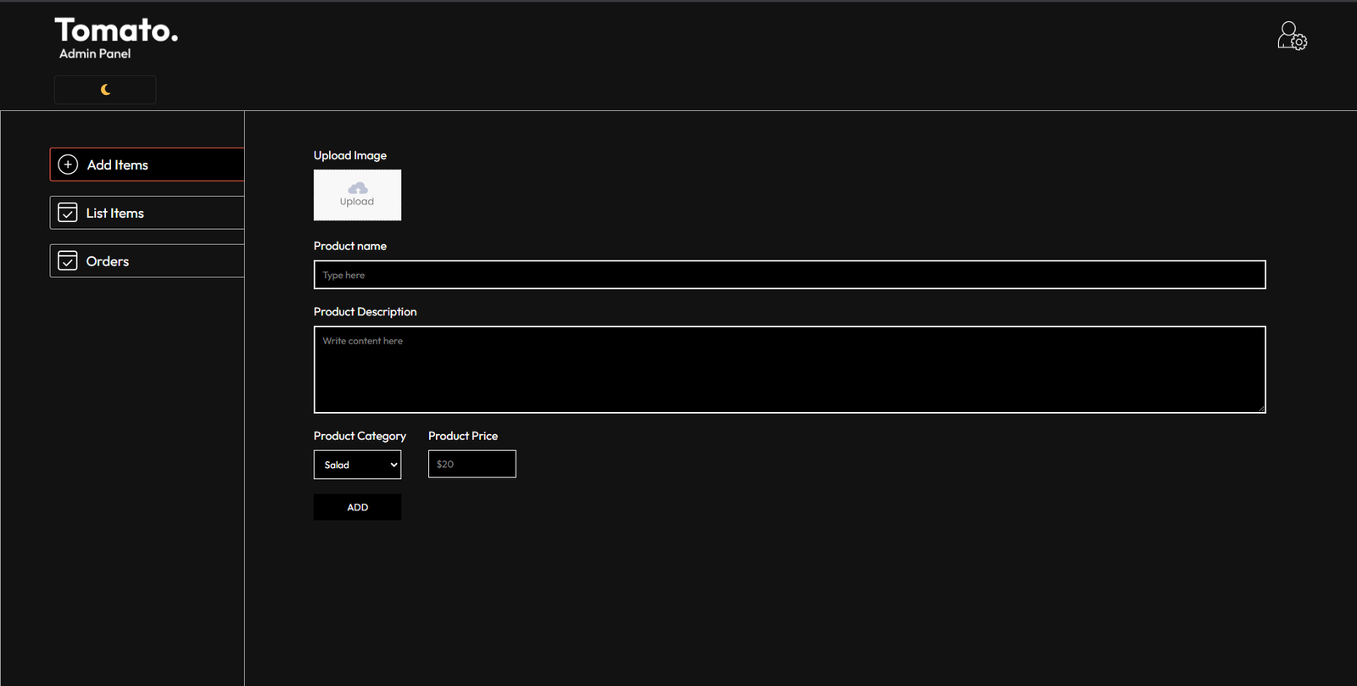
Modelling & Result

Slide 11

Conclusion
Tomato successfully provides a modern and optimized food delivery experience.
It ensures smooth order management, real-time updates, and a user-friendly interface.
The MERN stack implementation makes it scalable and efficient for real-world use.
Future scope: Adding AI-based food recommendations and a loyalty reward system.

Slide 12


Notes:
Thank You !!

